Slide 1

Analysis and Modeling of Internet Metrics to Estimate Rate of Social and Financial Success for High-Tech Ventures
Team 01
Bardia Mojra
David Dodson
Ethan Le

Slide 2
Background
Pioneers:
Thomas J. Watson (IBM)
David Packard and William Hewlett (HP)
Bill Gates and Paul Allen (Microsoft)
Jeff Bezos (Amazon)
Larry Page and Sergey Brin (Google)
Elon Musk (Zip2, PayPal, Tesla, and SpaceX)

Slide 3
Background
Common grounds:
They all know their stuff
Work tirelessly and know no luck
The goal is to win. Period
“The best or nothing” - Gottlieb Daimler
Practice great leadership
They harness the talents of others and unite them
Plan strategically and fire the first shot
They know the risks and feel no fear
If it is not luck then how do they do it repetitively?

Slide 4
Objectives
Analyze great successes and failures
Propose a more comprehensive model compared to traditional models
Utilize internet publications as feedback
Develop a new algorithm to automate process
Adjust the weighting factors via DoE

Slide 5
Plan of Action
Phase 1
Analyze industry pioneers and propose a model
Phase 2
Test and adjust the model via Design of Experiment concept
Development of Online Word Feedback Algorithm (OWFA)

Slide 6
Phase 1
Study and analyze industry pioneers
Financial growth histogram
Business development tragedies
Team leadership models
Social influence and public relations
Social reputation and customer trust

Slide 7
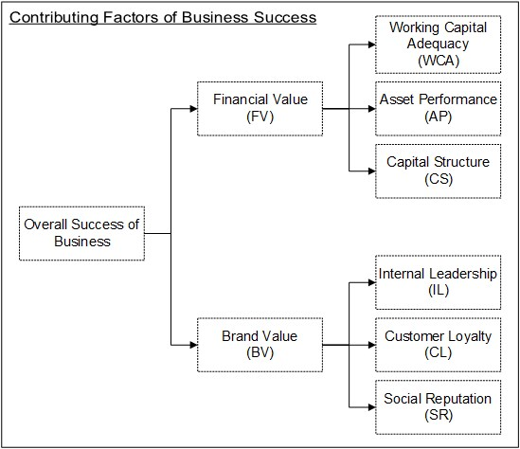
Model: Financial and Brand Value
Proposing two parallel dependent variables:
Financial Value (FV)
Working Capital Adequacy (WCA)
Asset Performance (AP)
Capital Structure (CS)
Brand Value (BV)
Internal Leadership (IL)
Customer Loyalty (CL)
Social Reputation (SR)

Slide 8
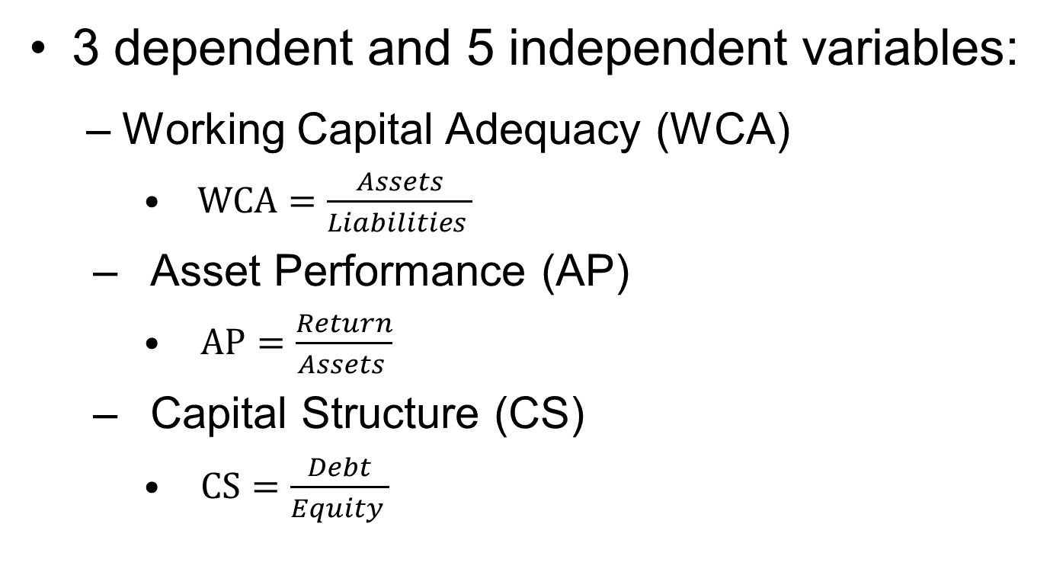
Financial Value
3 dependent and 5 independent variables:
Working Capital Adequacy (WCA)
$WCA=\frac{Assets}{Liabilities }$
Asset Performance (AP)
$AP=\frac{Return}{Assets }$
Capital Structure (CS)
$CS=\frac{Debt}{Equity }$

Slide 9
Brand Value
3 dependent variables
Internal Leadership (IL)
Social (organizational) response time to new ideas or problems
Customer Loyalty (CL)
Percentage of customers who do not consider going to competitors
Social Reputation (SR)
How media (reviewers) evaluate one product to its competition

Slide 10
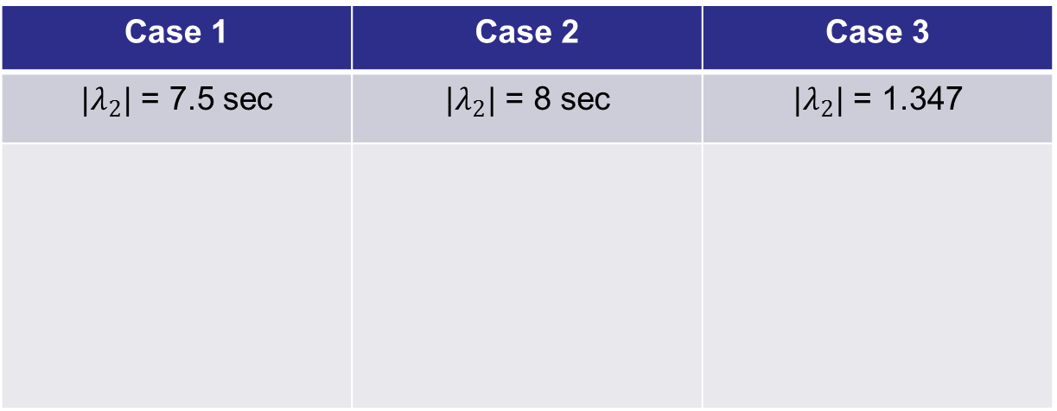
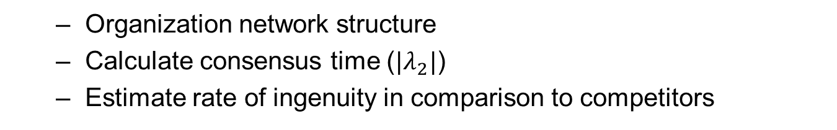
Internal Leadership
Organization network structure
Calculate consensus time ($|λ_{2}|$)
Estimate rate of ingenuity in comparison to competitors
Case 1 | Case 2 | Case 3
$|λ_{2}|$ = 7.5 sec | $|λ_{2}|$ = 8 sec | $|λ_{2}|$ = 1.347
Case 1
L
L
1
1
2
4
2
4
3
3
Cases simulated by Abhijit Das

Slide 11
Customer Loyalty and Social Reputation
Customer Loyalty
Percent of customers who don’t consider switching
Social Reputation
Reviewer score based on OWFA
Word scores of

Slide 12

Phase 2
Model:
$$M_{Rank}=\left(ω_{F}V_{F}\right)+\left(ω_{B}V_{B}\right)$$
$$V_{F}=\left(WCA\right)ω_{WCA}+\left(AP\right)ω_{AP}+(CS)ω_{CS}$$
$$V_{B}=\left(λ_{IL}\right)ω_{IL}+\left(CL\right)ω_{CL}+(SR)ω_{SR}$$

Slide 13
Timeline
TASK | Y1 Q1 |  | Y1 Q2 |  | Y1 Q3 |  | Y1 Q4 |  | Y2 Q1 |  | Y2 Q2 |  | Y2 Q3 |  | Y2 Q4
Phase One:
Gather Financial Data
Analyze Financial Data
Perform Consumer Surveys
Create Article Algorithm
Implement Article Algorithm
Analyze Social Data
Build Model
Phase Two:
Apply Model to Businesses
Analyze Model Accuracy

Slide 14
Key Personnel
Project Lead
Research Officer
Data Science Researcher
Javascript Developer
NET Developer
Research Assistant

Slide 15
Budget
A. PERSONNEL | Base Salary (Monthly) | Fringe Rate | Year 1 % | Year 2 % | Person- Months (Y1) | Person- Months (Y2) | Salary Amount/ Budget | Fringe
Project Lead | 3,500 | 20 | 50 | 50 | 6 | 6 | 42,000 | 8,400
Research Officer | 3,000 | 20 | 50 | 50 | 6 | 6 | 36,000 | 7,200
Stat/Prob Researcher | 2,000 | 25 | 40 | 15 | 4.8 | 1.8 | 13,200 | 3,300
Javascript Dev. | 2,000 | 25 | 15 | 40 | 1.8 | 4.8 | 13,200 | 3,300
.NET Dev. | 2,000 | 25 | 15 | 40 | 1.8 | 4.8 | 13,200 | 3,300
Research Assistant | 1,000 | 30 | 100 | 100 | 8 | 8 | 16,000 | 4,800
B. EQUIPMENT
Total Equipment |  |  |  |  |  | Total | 2,500
 | Server |  | 2,000
 | Misc. |  | 500

Slide 16
Budget
C. TRAVEL
5 trips for surveys (Local) |  | Avg. Per Trip | 150 |  |  | Total | 750
D. OTHER DIRECT COSTS
Material & Supplies |  |  |  |  |  | Total | 500
 | Survey |  | 500
TOTAL DIRECT COSTS (TDC) |  |  |  |  |  |  | 137,350
MODIFIED TDC (Without equipment) |  |  |  |  |  |  | 134,850
INDIRECT COSTS (Fringe) |  |  |  |  |  |  | 30,300
TOTAL PROJECT COST |  |  |  |  |  |  | 167,650

Slide 17
Thanks you
Questions

